Slide 1
Interaction Diagrams
Illustrate how objects interacts with each other.
Emphasizes time ordering of messages.
Can model simple sequential flow, branching, iteration, …etc
Sequence Diagrams

Slide 2
Introduction
Why do objects exist?
  To perform an activity to help fulfill a system’s purpose
Interaction Diagrams are used to model system dynamics
  How do objects change state?
  How do objects interact (message passing)?

Slide 3
Communication & Sequence Diagrams
An Interaction Diagram is a generalization of two specialized UML diagram types
  Communication Diagrams: Illustrate object interactions organized around the objects and their links to each other
  Sequence Diagrams: Illustrate object interactions arranged in time sequence

Slide 4
Communication & Sequence Diagrams (2)
Both diagram types are semantically equivalent, however, they may not show the same information
  Communication Diagrams emphasize the structural organization of objects, while Sequence Diagrams emphasize the time ordering of messages
  Communication Diagrams explicitly show object linkages, while links are implied in Sequence Diagrams

Slide 5
Basic Communication Diagram Notation
Link - connection path between two objects (an instance of an association)
Message - represented with a message expression on an arrowed line between objects
Sequence Number - represents the order in which the flows are used

Slide 6
Communication Diagrams
Objects are connected with numbered (sequenced) arrows along links to depict information flow
Arrows are drawn from the interaction source
The object pointed to by the arrow is referred to as the target
Arrows are numbered to depict their usage order within the scenario
Arrows are labeled with the passed message

Slide 7
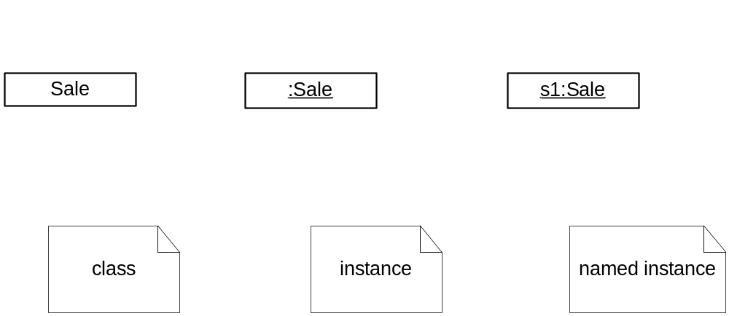
Common Interaction Diagram Notation

Slide 8
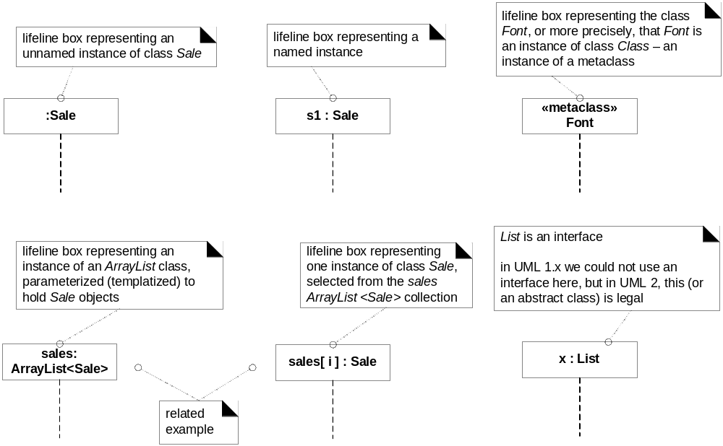
Common UML interaction diagram notations

Slide 9
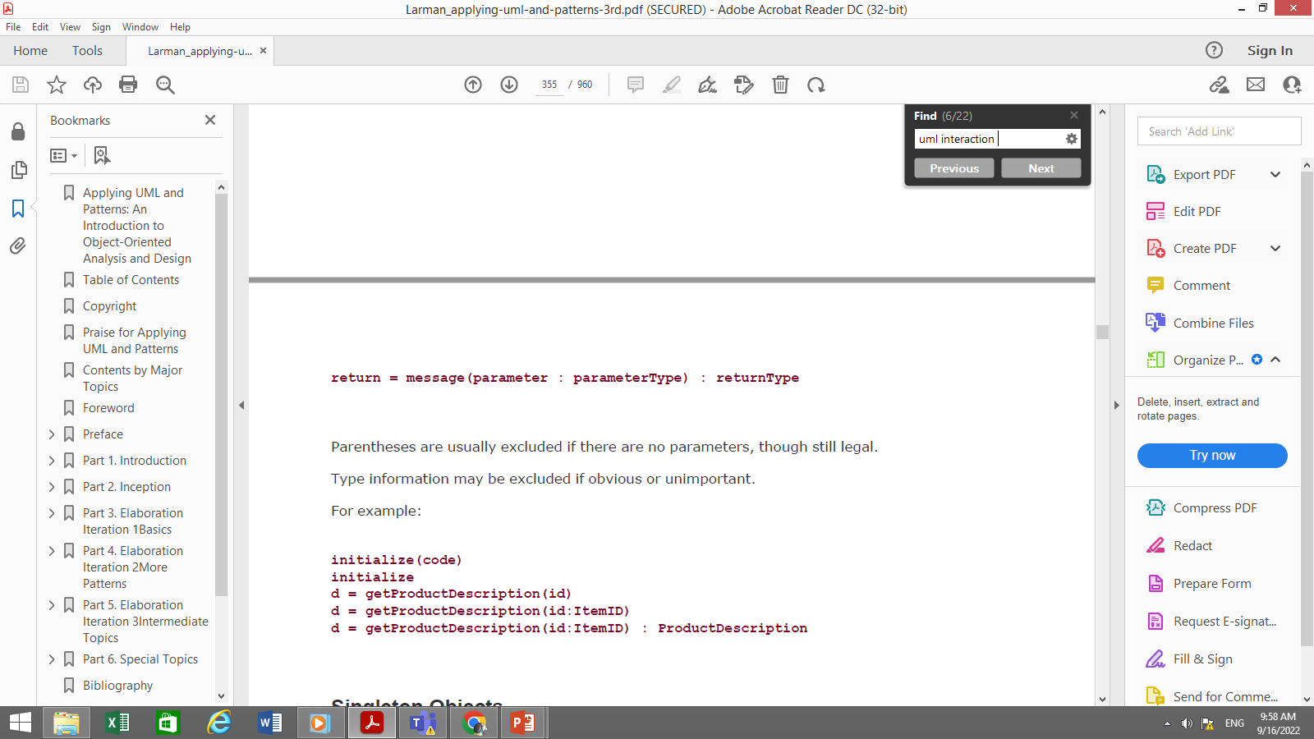
Basic message expression syntax

Slide 10
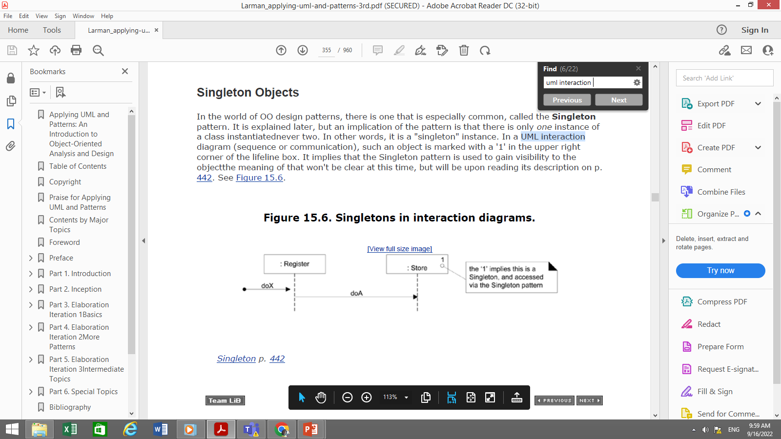

Singleton objects

Slide 11
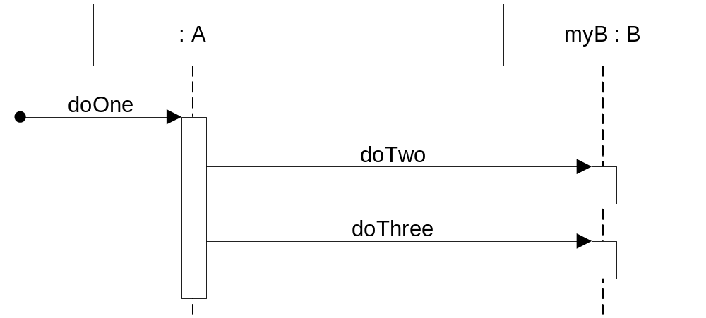
Sequence diagram

Slide 12
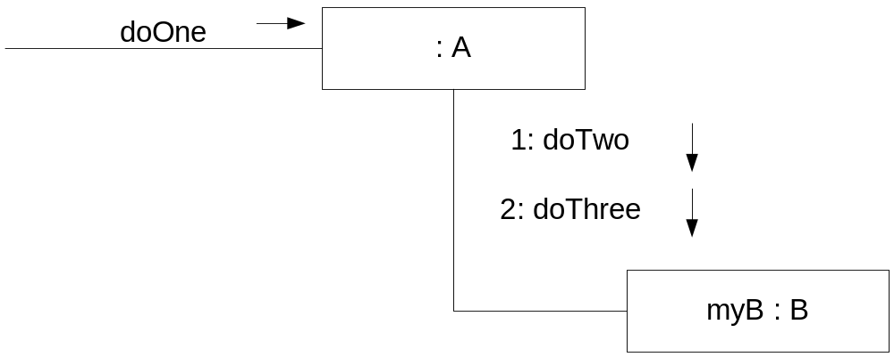
Communication diagram
Public class A
{
Private B myB = new B();
Public void doOne()
{
myB.doTwo();
myB.doThree();
}
//…..
}

Slide 13
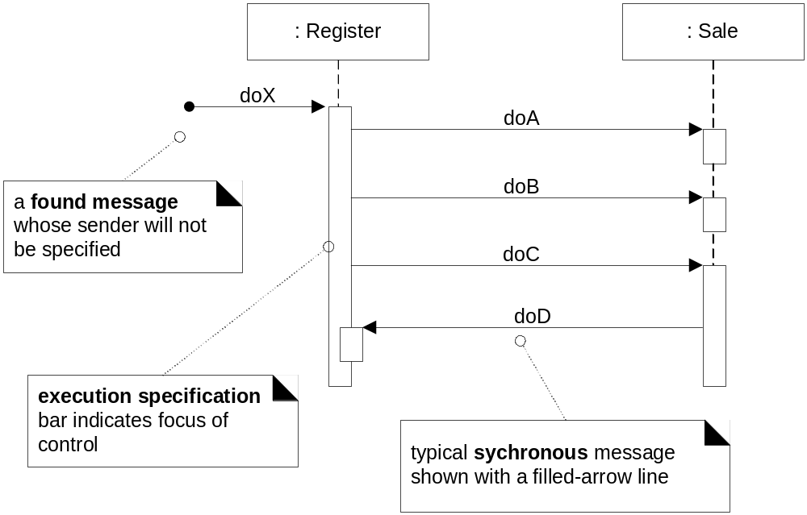
Sequence diagram notation
Life line boxes and life lines
Figure 15.7

Slide 14
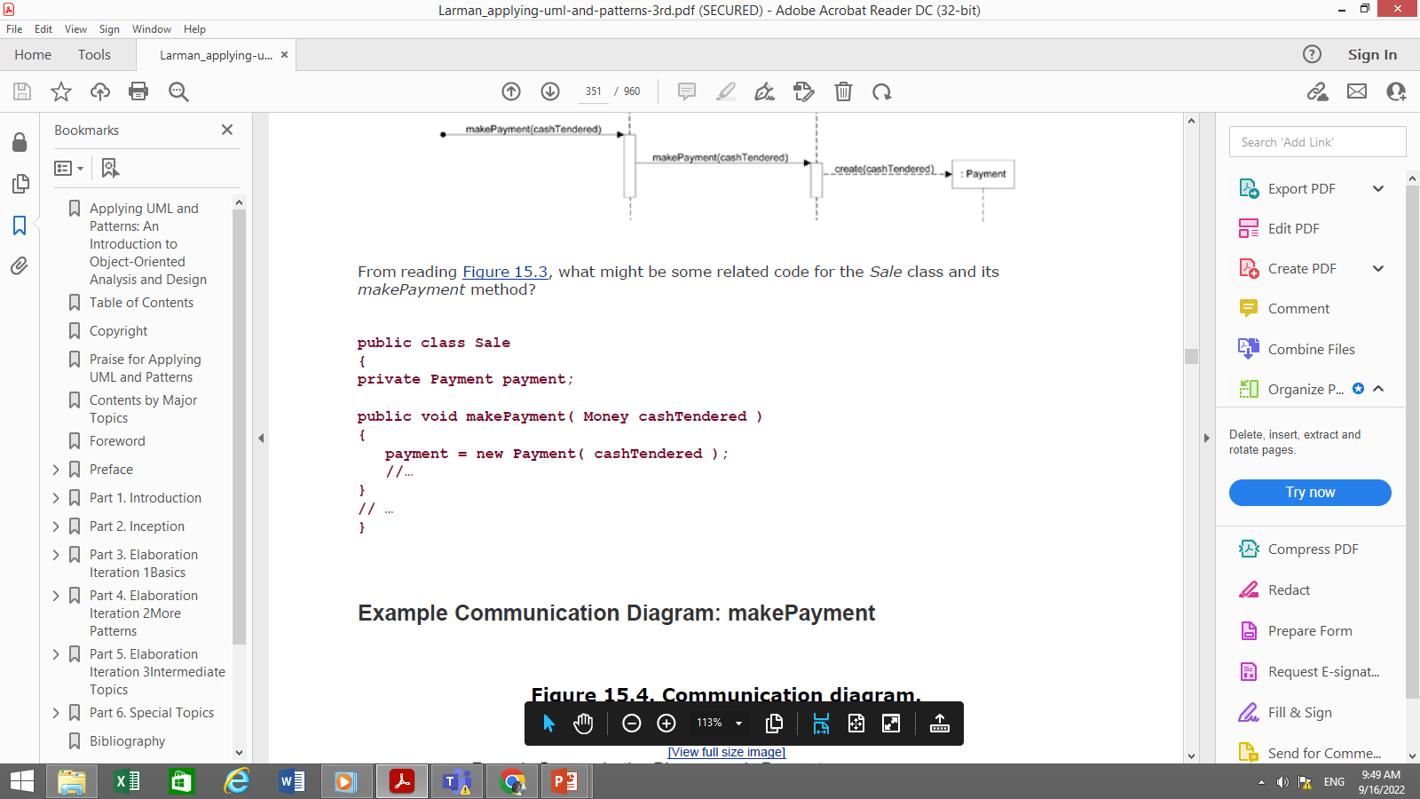
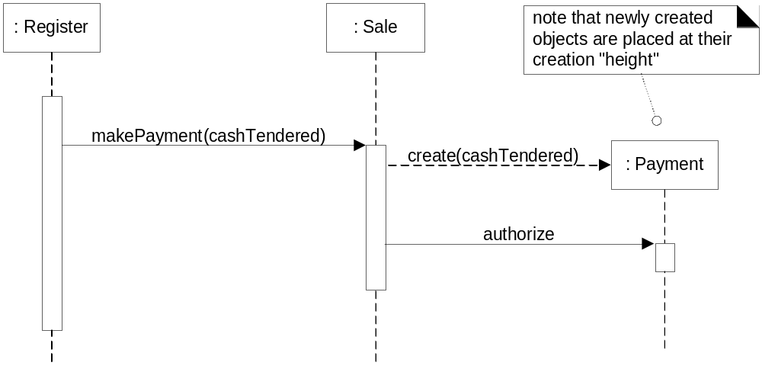
Creation of Instances
Figure 15.10

Slide 15
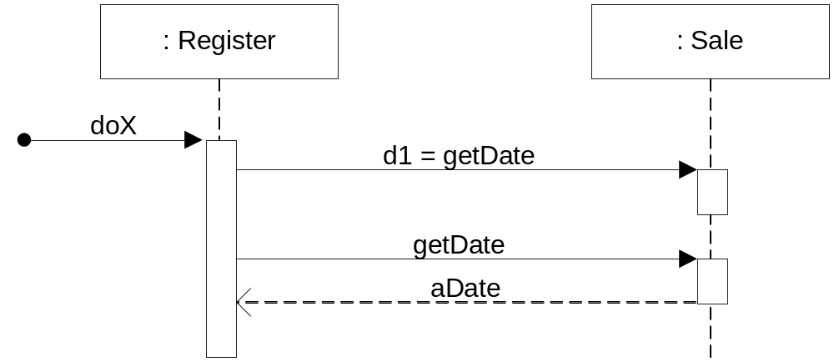
How to show a return result ?
2 ways to show return result:
Using returnVar=message(parameter)
Using a reply/return message line at the end of an activation bar

Slide 16
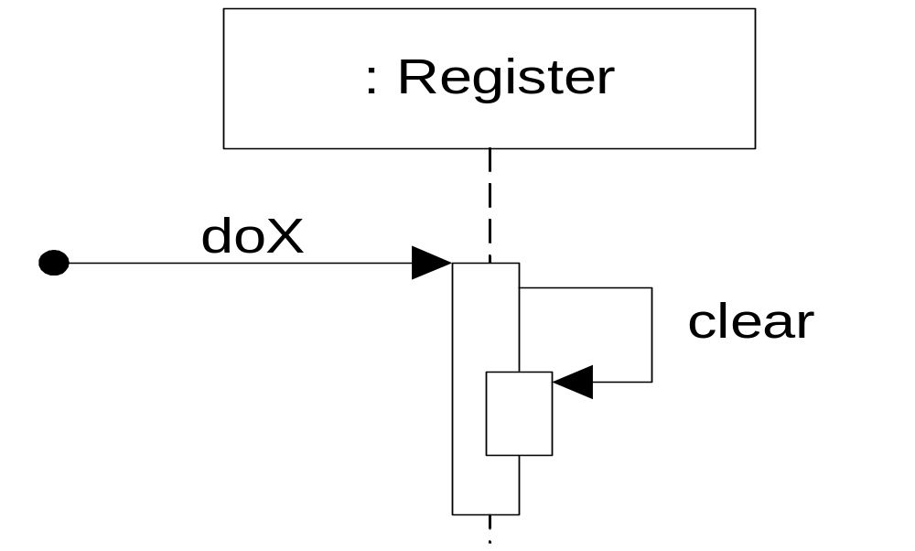
Messages to “self”

Slide 17
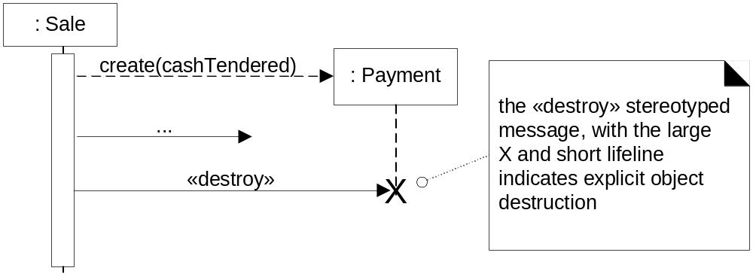
Object destruction

Slide 18
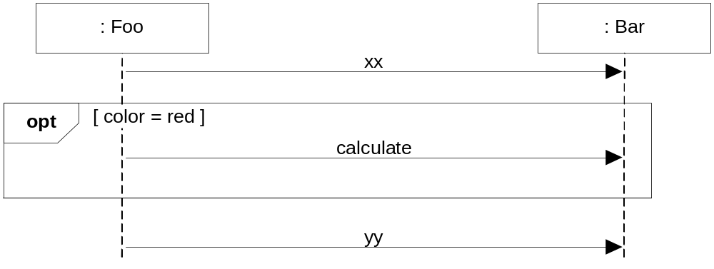
Conditional message : OPT frame is placed around one or more messages.
opt: Optional fragment that execute if guard is true
Figure 15.13

Slide 19
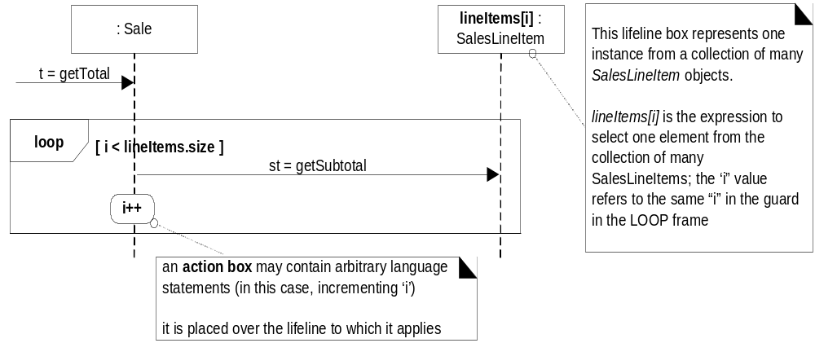
Loops (iteration over a collection) in sequence diagrams:
Figure 15.16

Slide 20
Public class Sale
{ private List<SalesLineItem> lineItems = new ArrayList<SalesLineItem>(); public Money getTotal()
{
Money total = new Money();
Money subtotal = null; for(SalesLineItem lineItem : lineItems)
{ subtotal = lineItem.getSubtotal(); total.add(subtotal);
} return total;
}
….//
}

Slide 21
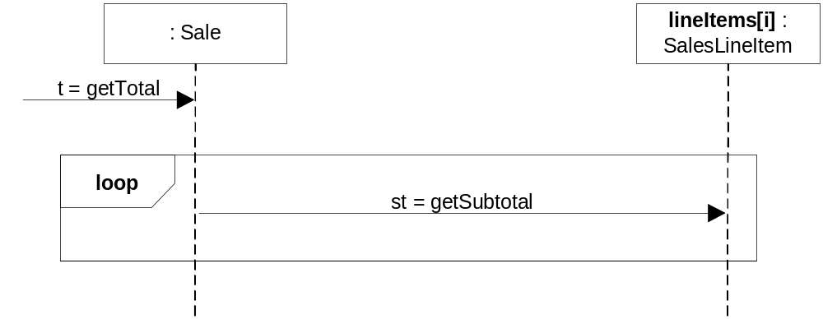
Loops (iteration over a collection) in sequence diagrams:
Figure 15.17
Which notation do you prefer?

Slide 22
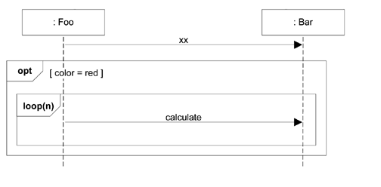
Nesting of frames

Slide 23
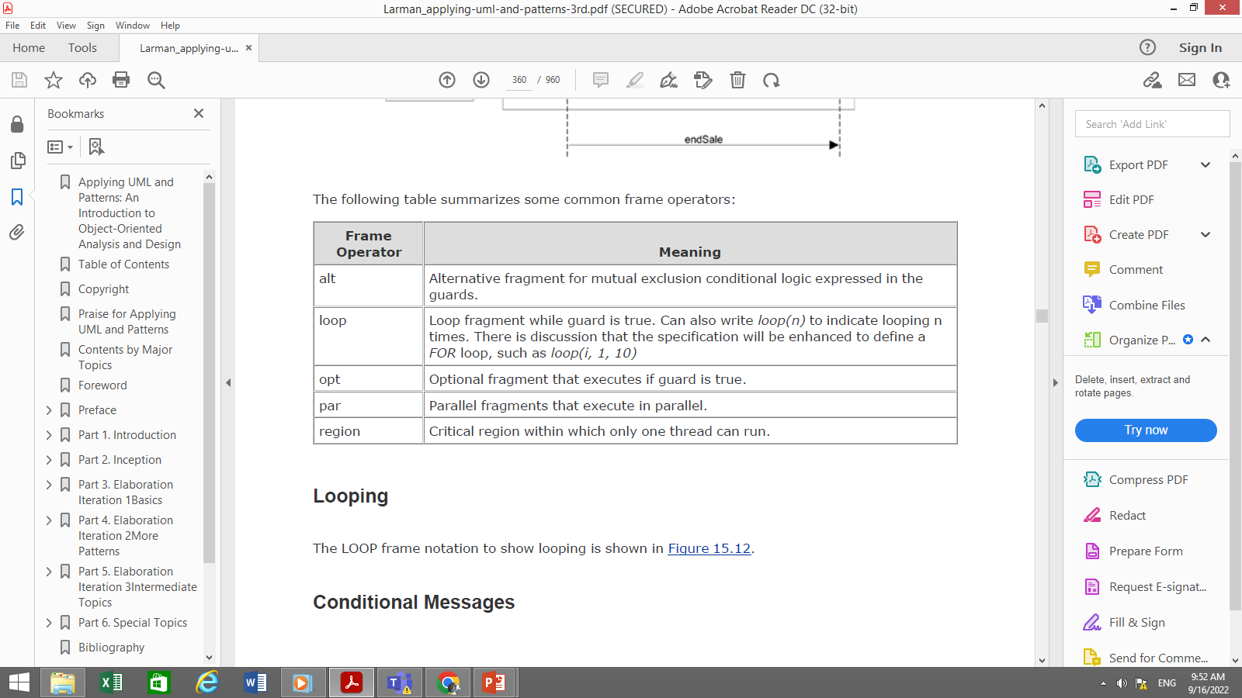

Slide 24
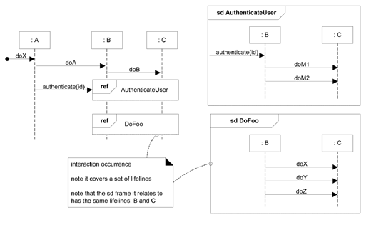
How relate Interaction diagram?

Slide 25
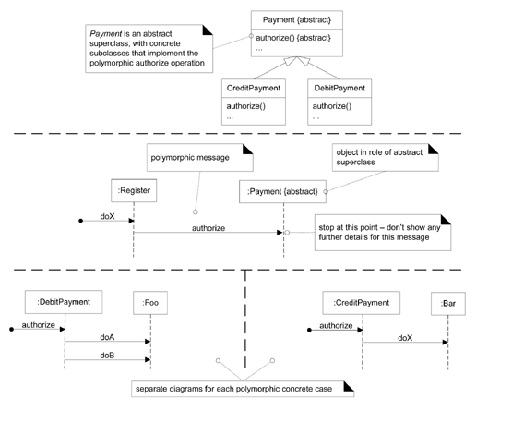
Polymorphism:
How is it shown in interaction diagrams?

Slide 26
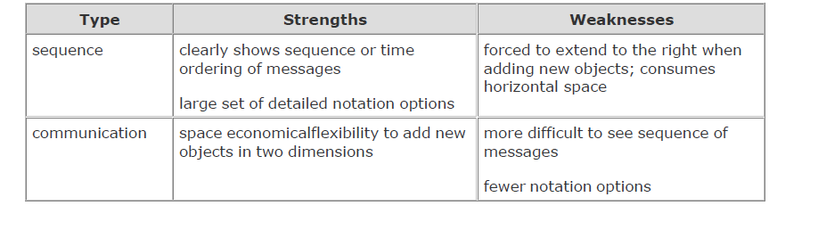

Slide 27
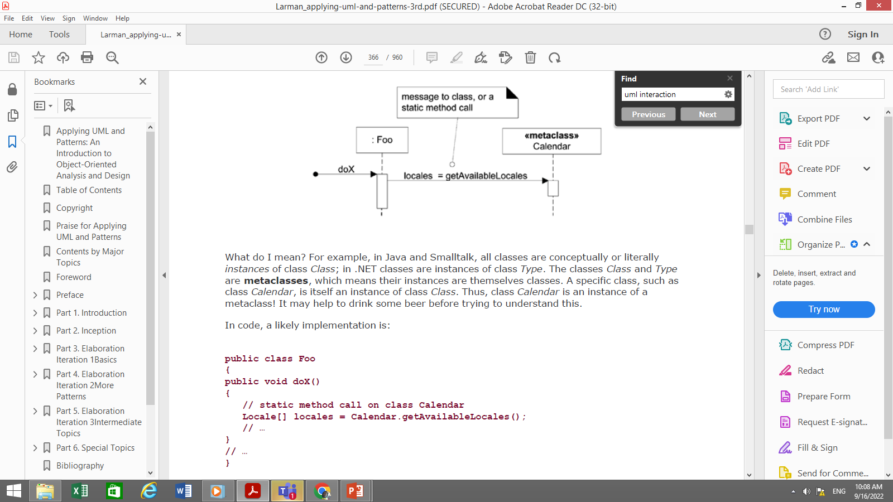
Messages to Classes to invoke Static methods

Slide 28
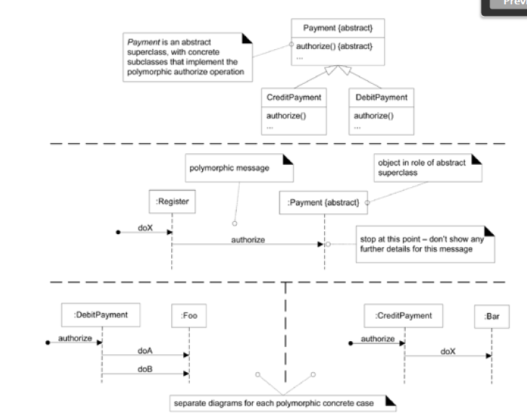
Polymorphic messages

Slide 29
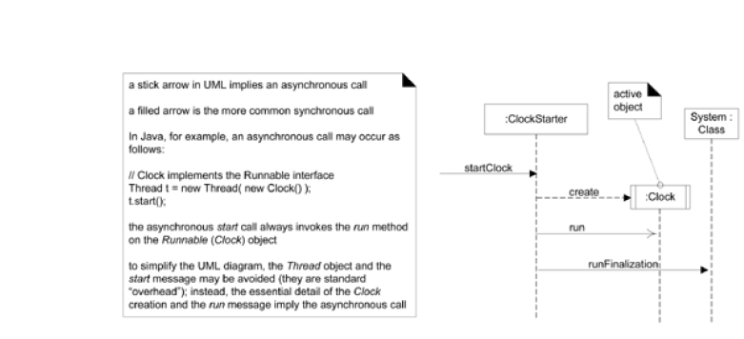
Asynchronous and synchronous calls

